Slide 1
An international, observational study of postoperative ileus and provision of management after colorectal surgery
Stephen Chapman and Ruth Blanco Colino
on behalf of the EuroSurg Collaborative

Slide 2
Background
Postoperative ileus (POI) – most common complication after elective colorectal surgery
A major source of adverse events, patient dissatisfaction, and increased costs
Many studies & too many outcome measures. Generalisable and homogenous data needed.
Notes:
Post operative ileus is the most common complication after elective colorectal surgery – estimated at around 12%.
Whilst not dangerous in its own right, its a major source of adverse events, mainly postop pneumonia and DVT
It also leads to patient disasitfaction and increased costs for healthcare systems - estimated at $1.4 billion dollars in the US per year.
There has been many studies testing different interventions – but are limited by a lack of homogeneity in outcomes measures. For this reason, they are poorly generalisable and the evidence for many remains inadeqaute.

Slide 3
Study Aims
To produce a profile of gastrointestinal recovery after elective colorectal surgery in a generalisable, international cohort
To assess the effect of NSAIDs on postoperative ileus when administered within the first 3 days after elective colorectal surgery.
To assess the safety of NSAIDs after elective colorectal surgery, including the risk of AKI and anastomotic leak.

Slide 4
Participants & timeline
Any European or Australasian hospitals performing colorectal surgery
Medical students, surgical trainees (residents), senior surgeons (consultants/attendings)
14-day data collection period
Between 22nd January and 19th March 2018

Slide 5
Inclusion Criteria
INCLUSION
All patients (18 years or over) undergoing:
Elective procedures ONLY
Any surgical approach
- Colonic resection
- Rectal resection
- Reversal of stoma

Slide 6
Exclusion Criteria
EXCLUSION
- Emergency and ‘unplanned’ procedures
- Diagnostic laparoscopy/laparotomy without resection
- Inguinal, incisional or femoral hernia, without colorectal resection
- Appendicectomy
- Transanal surgery
- Primarily urological, gynaecological and vascular procedure
- Surgery involving multi-visceral surgery

Slide 7
Outcome Measures
Primary outcome measure
Time (days) until gastrointestinal recovery (GI-2)
Tolerance to solid intake and absence of vomiting
AND passage of stool
Oral tolerance (solids/soft food) with no vomiting
Presence of bowel motions (at least one stool)
AND
Notes:
Well, now I’m going to talk about the outcome measures for IMAGINE study. We are assessing GI recovery, for this reason our ... primary outcome measure is the time (measured in whole days) until return of bowel function (GI-2). This is a composite measure of:
Oral tolerance to solid/soft food intake for 24 hours with no vomiting
AND presence of bowel motions considered as passage of stool
The composite outcome for return of bowel function (GI-2) should be assessed daily for the first ten days after surgery (Day 0; day of surgery – Day 10). This

Slide 8
Outcome Measures
Secondary outcome measure
Overall 30-day adverse event rate according to the Clavien-Dindo scale of postoperative complications
Incidence of anastomotic leak
Incidence of AKI
Notes:
As secondary outcome measures:
The overall 30-day adverse event rate according to the Clavien-Dindo scale of postoperative complications will be considered.
Also, the incidence of anastomotic leak, defined according to leakage detected radiologically or during surgery
And the Incidence of acute kidney injury, defined according to KDIGO
Patients will be followed for 30 days after surgery. All secondary outcome measures will be recorded if they occurred at any point from post-operative day 0 (day of surgery) to Day 30.

Slide 9
Clavien-Dindo Classification
I | Deviation from the normal postoperative course without other than the “allowed therapeutic regimens”
II | Requiring pharmacological treatment
III | Complications requiring surgical, endoscopic or radiological intervention
IV | Life-threatening complications requiring critical care management – single organ or multi-organ dysfunction
V | Death of a patient
Notes:
Just to say briefly that Clavien Dindo scale, as many of you know, identifies complications and classifies them by therapeutic consequences.
I – deviation from standard postoperative course within ‘allowed therapeutic regimes’
II – complication requiring pharmacological treatment
III – complication requiring surgical, endoscopic or radiological intervention
IV – complication requiring critical care management
V – death of a patient
In ES-1 We included grades III to V, so those complications requiring surgical, endoscopic or radiological intervention, Life-threatening complications requiring critical care management or the Death of a patient.

Slide 10
Data Collection
Notes:
Data will be collected and stored online through REDCap. REDCap stands for Research Electronic Data Capture and it is secure, online web application, widely used internationally by academic organisations to store research databases.

Slide 11
Data Collection

Slide 12
Quality Assurance
Mini-teams
Three individuals → including at least one medical student and one trainee.
IMAGINE E-learning modules prior data collection
Data completeness
Only data sets with >95% data completeness will be accepted for pooled international analysis.
Data validation
Notes:
Quality assurance for IMAGINE study includes:
The composition of Mini-teams by Three collaborators collecting data at each mini-team, at least one medical student and one trainee. The study should also be registered with a supervising consultant (attending) surgeon at each site.
IMAGINE E-learning modules
To maximise the educational value of IMAGINE, and to ensure understanding of key steps, all collaborators will undertake a series of short e-learning modules prior data collection. These modules will cover:
Study set up and governance
Measurement of bowel function
Clavien-Dindo Classification System
REDCap User Guide
For Data completeness - Only data sets with >95% data completeness will be accepted for pooled international analysis.
Data validation
Moreover, data validation over data ascertainment /aserteinment/ and data accuracy will be performed in five hospitals in each participating country

Slide 13
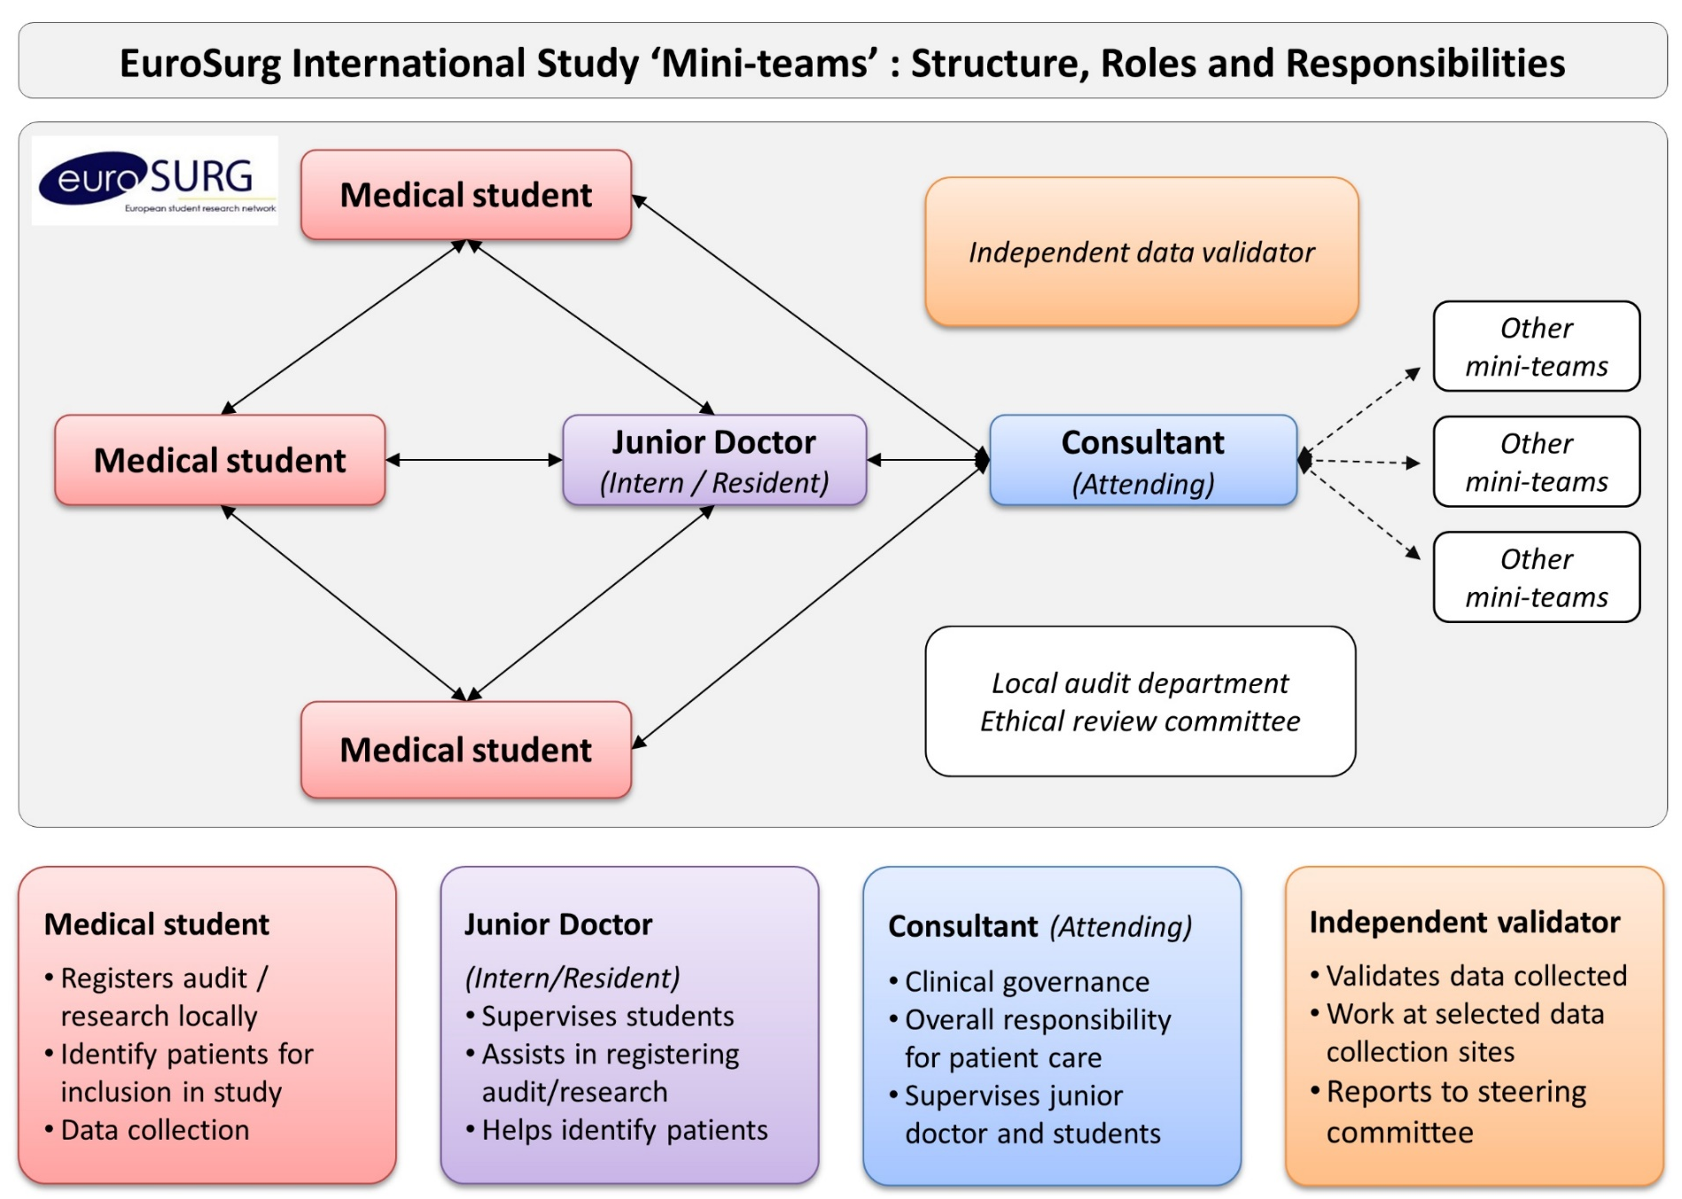
Project Team Structure
Notes:
How are the EuroSurg teams organized?
Medical students and trainees/residents will take the lead in disseminating and delivering IMAGINE study.
Students and trainees will form mini-teams at their local hospitals. Mini-team are formed by a medical student collaborating with a surgical trainee and a third collaborator that can be a student or trainee. Multiple mini-teams can participate at each centre, collecting data during distinct two-week periods within the data collection phase. Mini-teams must be supervised by a consultant (attending) surgeon who gives support to them at each participating centre.
Teams of students and trainees/residents will collaborate to form ‘mini-teams’, with up to three investigators per mini-team.
A team of three students/trainees responsible for data collection over one specific data collection period at one hospital.

Slide 14
STUDY MANAGEMENT GROUP
NATIONAL NETWORK COMMITTEE
LOCAL LEAD
LOCAL LEAD
LOCAL LEAD
MINI-TEAM
MINI-TEAM
MINI-TEAM
MINI-TEAM
MINI-TEAM
MINI-TEAM
MINI-TEAM
Notes:
Mini-teams will be coordinated by local leads that will act as a link between local collaborators and their national networks. At the same time, national committee networks will act as a link with the steering committee.
Core group of medical students and trainees/residents responsible for protocol design, data handling and management, analysis and drafting of the paper
a core group of medical students and trainees located in each participating country responsible for study dissemination, protocol translation and supporting students to correctly
register and run the study at each participating centre.

Slide 15
Small group discussion
What is the most effective way to build/support your national network?
What is the best way to identify eligible patients? What are the challenges?
How would you proactively follow-up the included patients at your centre? There is something that would help support students better?
Notes:
Now is your turn to discuss about IMAGINE protocol, here are some points you should cover:
What is the most effective way to build/support your national network?
What is the best way to identify eligible patients? What are the challenges?
How would you proactively follow-up the included patients at your centre? There is something that would help support students better?
Strategies to record bowel function
• Speaking to ward staff, including doctors and nurses
• Reviewing patient medical and nursing notes/charts daily, particularly for events occurring at night
• Participating in daily ward rounds and doctor reviews
Remember: recordings of bowel function must correspond to the entire day. It is advised that you consider these symptoms one day in retrospect to capture all relevant data.
Strategies for follow-up include:
• Regularly reviewing patient notes to identify in-hospital complications
• Participating in daily ward rounds and doctor reviews
• Reviewing clinic notes and clinic letters, if seen in clinic by 30 days
• Checking electronic systems and handover lists for re-admissions
• Checking for emergency department re-attendances

Slide 16
The European Student Research Network
www.eurosurg.org
@EuroSurg
https://www.facebook.com/EuroSurg/
info@eurosurg.org
Project Summary: goo.gl/QM32tZ

